Slide 1
ESPx-Cloud
Team 09

Slide 2
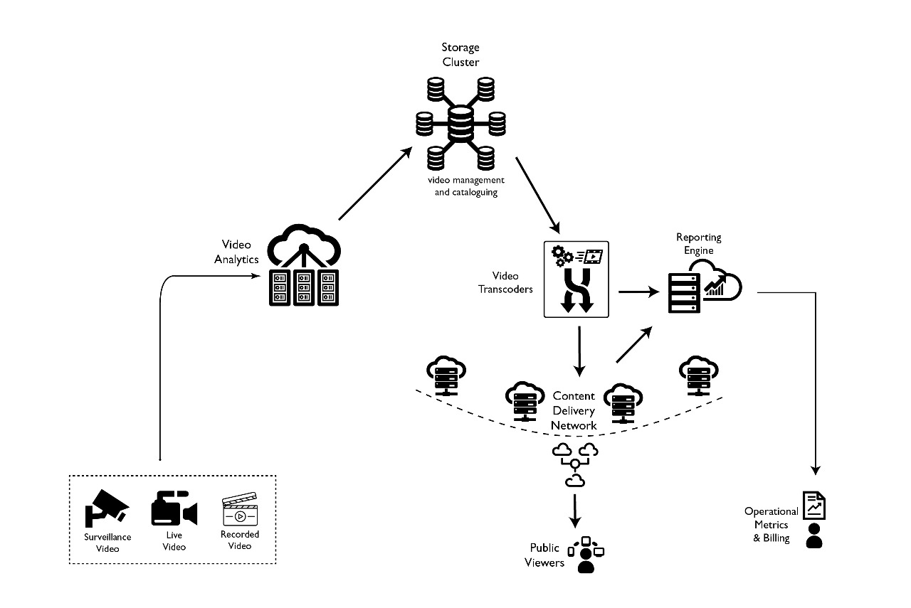
Existing ESPx Cloud - Our Understanding

Slide 3
Requirements - Grouping
Billing
Subscription
Usage Tracking
Video-Engagement
Interactive Communication
Live Charting
Reporting
iOS/Android App

Slide 4
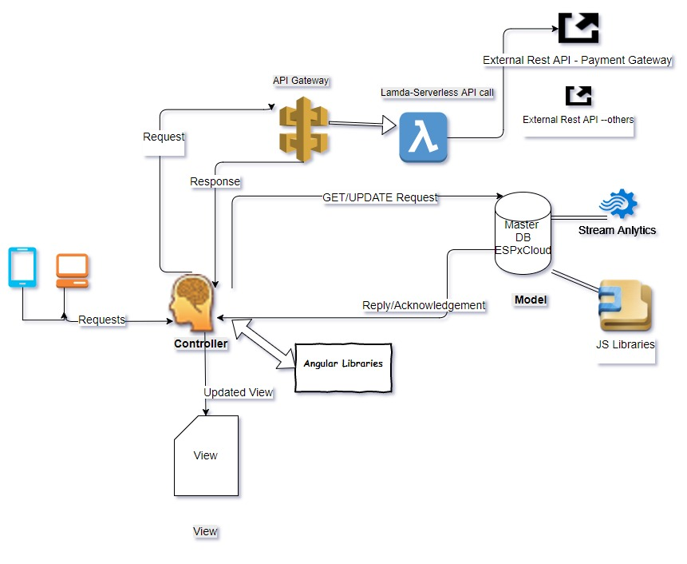
General Architecture
MVC pattern
Service Controllers
Loosely Coupled Model and View
Ng Model
Ng APP
Ng Bind

Slide 5
Billing Module
Constraints
• Has Dependency with Subscription and Usage Tracking
• Security – SSL,TLS

Slide 6
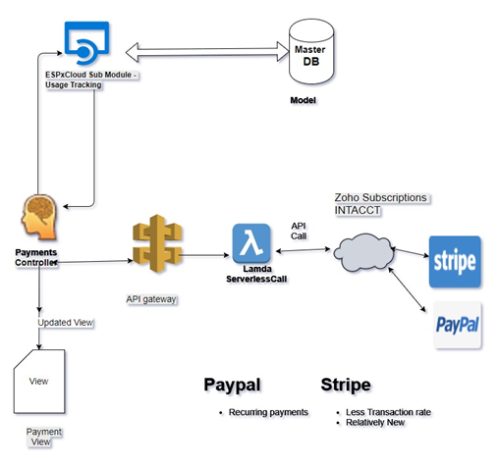
Zoho Subscriptions
Stripe - Low Transaction Rate
Paypal Recurring Payments
Why AWS Gateway? Secure API calls
Reliable
Very very cheap

Slide 7
Live Charting - Reporting- Exporting
The items to be recorded and analyzed
number of views
whether like or dislike
whether to share
whether to comment
time on watch
duration time on watch
number of concurrent viewers
(features of audience——use to cluster audience)
2. Libraries (JavaScript)
Plotly JS (based on D3 JS)
Chart JS (HTML rendering)
Smoothie JS (stream real time data)
JS Report - Exporting Completely Free

Slide 8
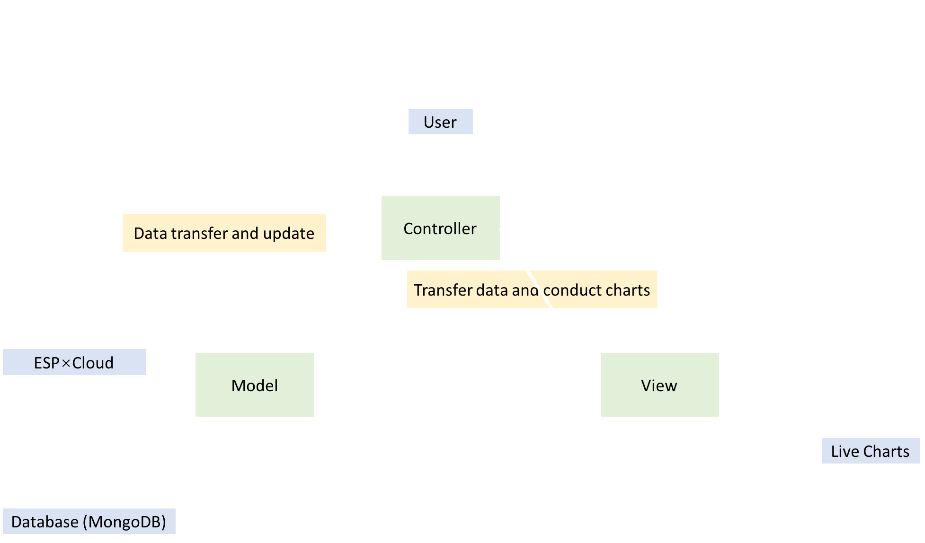
Live Charting - Reporting- Exporting
4. Architecture Diagram

Slide 9
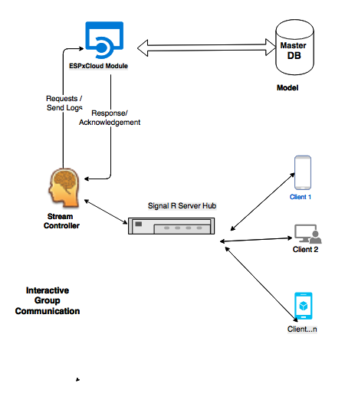
Interactive Communication - Signal R
https://github.com/JustMaier/angular-signalr-hub
Open source Library
Scalable , Very popular
Very similar to SOCKET.IO in Node.JS
Supports Negotiation with Fallback

Slide 10
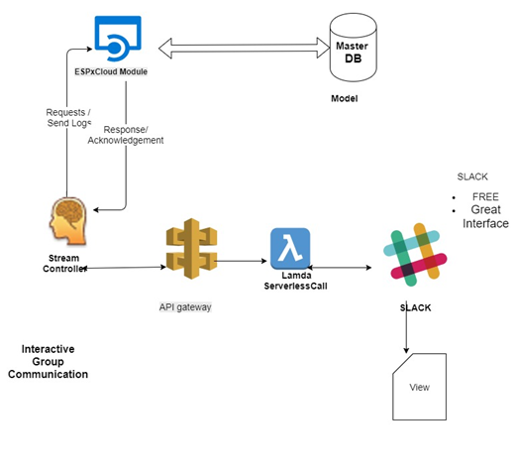
Interactive Communication using slack

Slide 11
Viewer Engagement Modules
•Inside-Out to Outside- IN
•Unique User
–Store User Info
–Cookie
–Geo-Location
–Browser,Size of the Mob screen
–Lite version for the Low-end Mobile users

Slide 12
Other Niche Ideas
Signal R - BOT To answer FAQ’s.
Signal R- BOT to Generate Reports.
Optical Character recognition .

Slide 13
SDK - Android and iOS
Hybrid App Development
Use CORDOVA
Re usability of Existing Web-APP
SAME API’s , Design is adaptable to HYBRID APP development

Slide 14
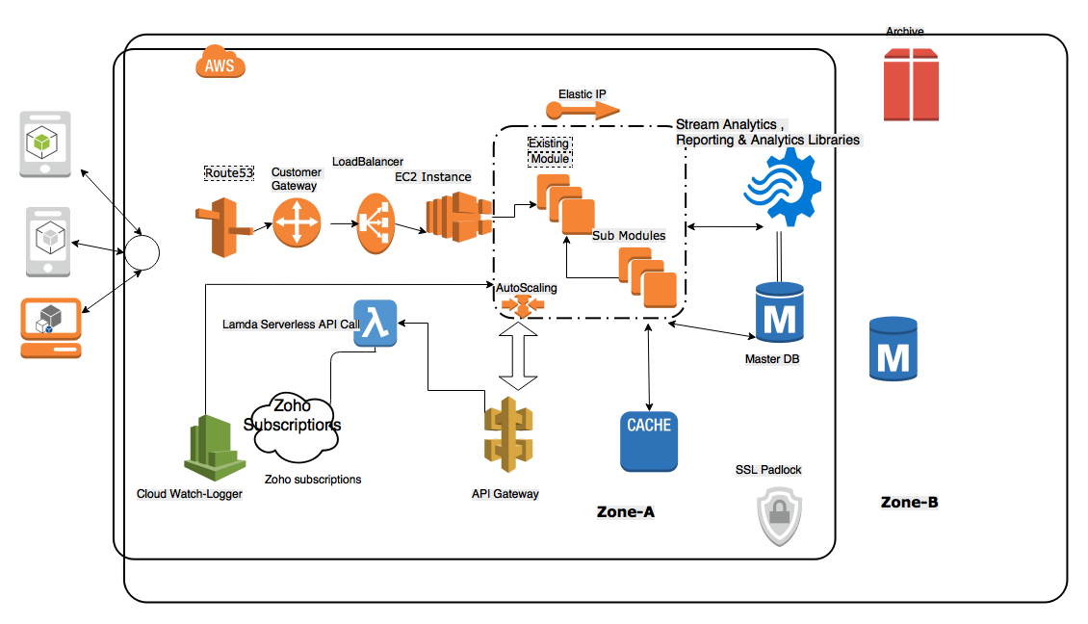
Final Deployment Diagram

